Slide 1

Project Phase – I , Presentation on “SWARMING OF DRONES”
(SPONSORED BY: DRDO)
(Domain : Robotics and IoT)
By : Group No. – A03
Under Guidance of MR. VISHAL AMBHORE
Year
2019-2020
Roll No. | Division | Name | Contact No.
411037 | A | Rushikesh Gamare | 7020260394
411038 | A | Kunal Gandhi | 8208859454
411062 | A | Amey Kore | 9404736709
Bansilal Ramnath Agarwal Charitable Trust’s
Vishwakarma Institute of Information Technology
Department of Electronics & Telecommunication

Slide 2
PROJECT PHASE – I, outline
Introduction to Project
Component selection and software used
Result analysis and discussion
Application
References
Bansilal Ramnath Agarwal Charitable Trust’s
Vishwakarma Institute of Information Technology
Department of Electronics & Telecommunication

Slide 3
INTRODUCTION
What is Swarm? Why Swarm?
Swarm robotics is an approach to the coordination of multiple robots as a system which consist of large numbers of mostly simple physical robots. This approach emerged on the field of artificial swarm intelligence, as well as the biological studies of insects, ants and other fields in nature, where swarm behavior occurs.
Large number of simple robots can perform complex tasks in a more efficient way than a single robot, giving robustness and flexibility to the group.
To increase work efficiency by communicating with one another.
Bansilal Ramnath Agarwal Charitable Trust’s
Vishwakarma Institute of Information Technology
Department of Electronics & Telecommunication

Slide 4
Component list
Chassis
BLDC motor
Propeller
Landing gears
ESC
Flight controller
Power management board
Battery
GPS module
Receiver
Telemetry radio
Bansilal Ramnath Agarwal Charitable Trust’s
Vishwakarma Institute of Information Technology
Department of Electronics & Telecommunication

Slide 5
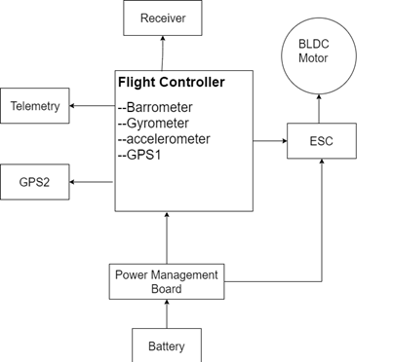
BLOCK diagram
Basic UAV block diagram with peripherals
Bansilal Ramnath Agarwal Charitable Trust’s
Vishwakarma Institute of Information Technology
Department of Electronics & Telecommunication

Slide 6
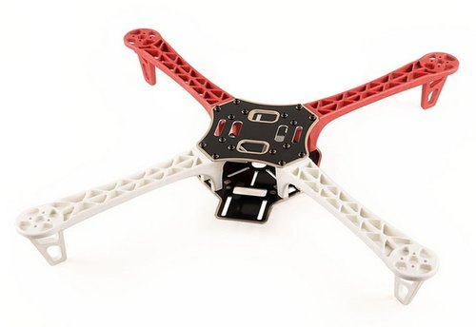
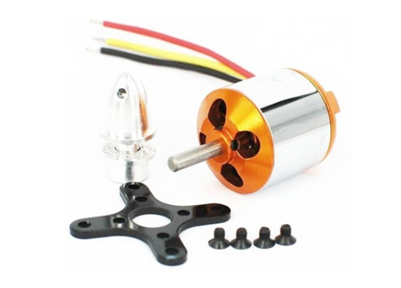
6(a).Hardware description
Chassis F450 chassis (selected)
Weight- 282g
BLDC motor 1800kv rpm(selected)
Max rpm at 12v – 21600
Weight – 48g
No load current - 0.5A
No load voltage – 10v
Thrust generated with 3s battery and 1045 propeller – 1.2kg
Bansilal Ramnath Agarwal Charitable Trust’s
Vishwakarma Institute of Information Technology
Department of Electronics & Telecommunication

Slide 7
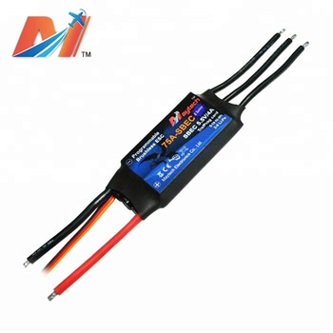
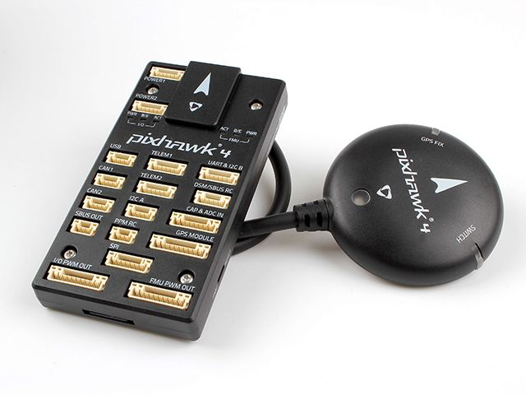
ESC 20A hobbyking (selected) PWM frequency – 8k Hz to 16k Hz
Flight controller PIXHAWK4(selected)
2mb flash memory (ROM)
512 mb RAM
Main soc microcontroller in px4 – STM32F427
Failsafe soc – STM32F100
Power management board Input – 12v to 30v
Output – 12v ,5v PWM
Bansilal Ramnath Agarwal Charitable Trust’s
Vishwakarma Institute of Information Technology
Department of Electronics & Telecommunication

Slide 8
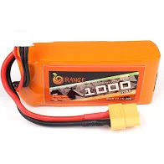
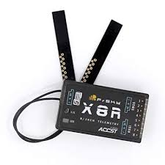
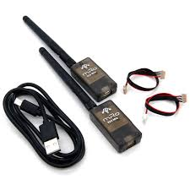
Battery 3s LiPo 3000 MAh
Min voltage- 10.2 V
Nominal voltage – 11.1 V
Max voltage – 12.6 V
Receiver – X8R 16 channel duplex communication
operating frequency - 2.4 GHZ
Operating voltage – 4v to 10v
Output voltage – 3.3 V Operating current – 100 mA at 5 V
Max range – 1.5 km
Telemetry radio – 433Mhz Range – 3 km
Operating voltage – 3 V to 6 V
Bansilal Ramnath Agarwal Charitable Trust’s
Vishwakarma Institute of Information Technology
Department of Electronics & Telecommunication

Slide 9
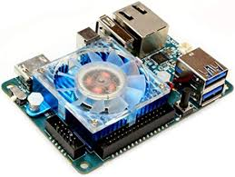
Odroid microprocessor Odroid XU4
USB ports – 3
RAM – 2 GB
Input voltage – 5 V
Input current – 4A
8 GB eMMC5.0 HS400 flash storage Operating system - Ubuntu 16.04
Power supply for odroid – 5v, 4A buck converter
5v,4A lps for testing(using LM350),MJE2955

Slide 10
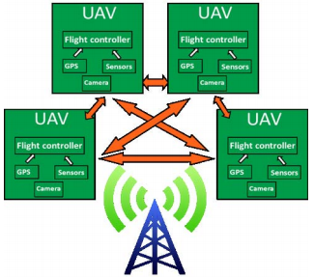
BLOCK dIAGRAM
→ Denotes communication through UDP.
Bansilal Ramnath Agarwal Charitable Trust’s
Vishwakarma Institute of Information Technology
Department of Electronics & Telecommunication

Slide 11
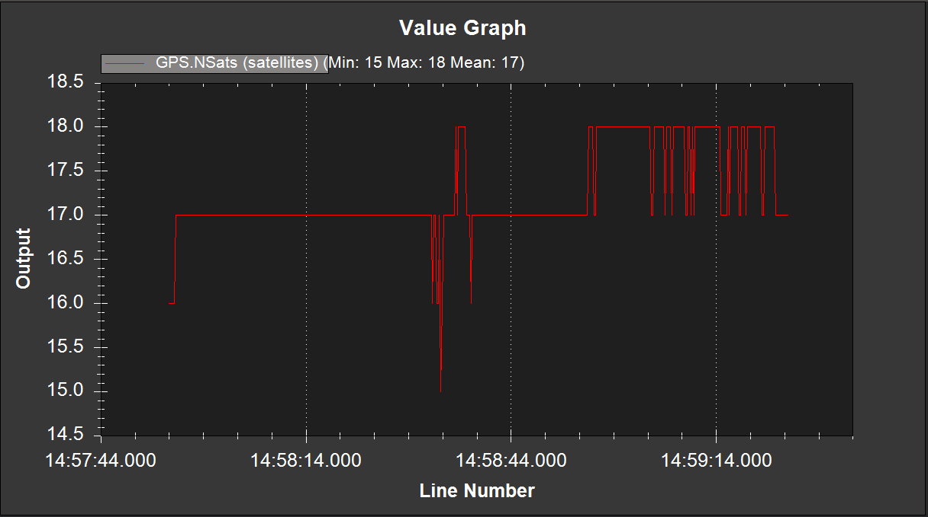
Result analysis and discussion
24 main GPS satellites orbit Earth every 12 hours, sending a synchronized signal from each individual satellite. Because the satellites are moving in different directions, a user on the ground receives the signals at slightly different times. When at least four satellites get in touch with the receiver, the receiver can calculate where the user is – often to a precision of just a few feet, for civilian use.
Bansilal Ramnath Agarwal Charitable Trust’s
Vishwakarma Institute of Information Technology
Department of Electronics & Telecommunication

Slide 12
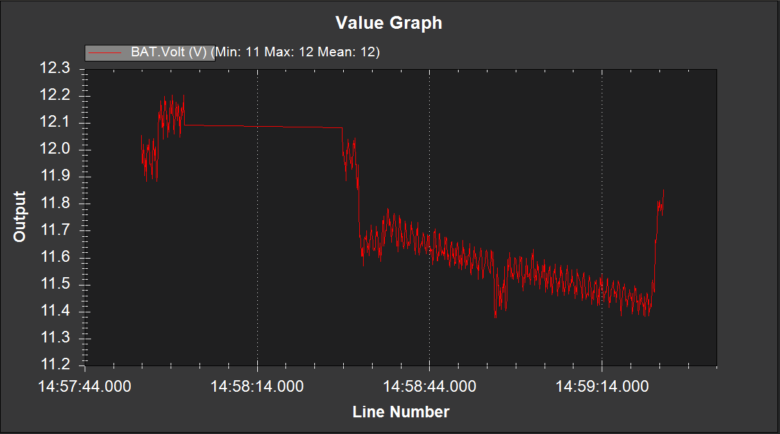
Result analysis and discussion
This is the log collected of the voltage of the battery during a single flight plan.It Shows the variation in the voltage supplied by the Battery to the system.
Bansilal Ramnath Agarwal Charitable Trust’s
Vishwakarma Institute of Information Technology
Department of Electronics & Telecommunication

Slide 13
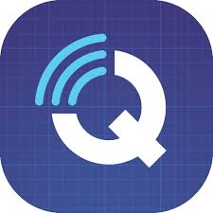

6(b).Required Software
Q ground controller
QGroundControl provides full flight control and mission planning for any MAVLink enabled UAV. Its primary goal is ease of use for professional users and developers. All the codes are open-source source, so you can contribute and evolve it as you want.
ArduPiolet
ArduPilot is an open source, unmanned vehicle Autopilot Software Suite, capable of controlling autonomous: Multi UAV’s, Ground rovers, Boats, Submarines.
Bansilal Ramnath Agarwal Charitable Trust’s
Vishwakarma Institute of Information Technology
Department of Electronics & Telecommunication

Slide 14

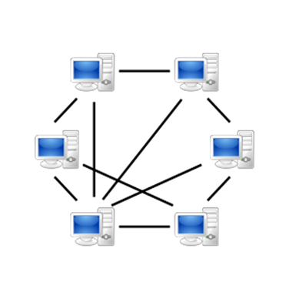
MAVLink(Micro Air Vehicle Link)
What is MAVlink?
Protocol for communicating with UAV’s.
It follows modern hybrid publisher-subscriber protocol.
UAV’s and central controlling unit connected each other by peer-to-peer network.
Peer-to-peer network shown below.
It mostly use to communicate within GCS and UAV’s.
Bansilal Ramnath Agarwal Charitable Trust’s
Vishwakarma Institute of Information Technology
Department of Electronics & Telecommunication

Slide 15
Key Features of MAVLink:
Very efficient.
MAVLink 2 has just 14 bytes of overhead.
Not required any additional framing.
Very reliable.
It provides methods for detecting packet drops, corruption, and for packet authentication.
Support many programing languages.
Can run on numerous microcontroller/operating systems(including ARM7, ATMega, dsPic, STM32 and Windows, Linux, MacOS, Android and iOS).
Allows 255 systems on network.
Enables both offboard and onboard communications (e.g. between a GCS and UAV, and between UAV autopilot and MAVLink enabled UAV camera).
Bansilal Ramnath Agarwal Charitable Trust’s
Vishwakarma Institute of Information Technology
Department of Electronics & Telecommunication

Slide 16
Dronekit and Dronekit SITL
It creates apps that can run on onboard companion computer and communicate with controller.
The API communicates with vehicles over MAVLink.
DroneKit Python APIs features:
Connect to a vehicle (or multiple vehicles) from a script
Get and set vehicle state/telemetry and parameter information.
Receive asynchronous notification of state changes.
Guide a UAV to specified position (GUIDED mode).
Send arbitrary custom messages to control UAV movement and other hardware (GUIDED mode).
Create and manage waypoint missions (AUTO mode).
Bansilal Ramnath Agarwal Charitable Trust’s
Vishwakarma Institute of Information Technology
Department of Electronics & Telecommunication

Slide 17
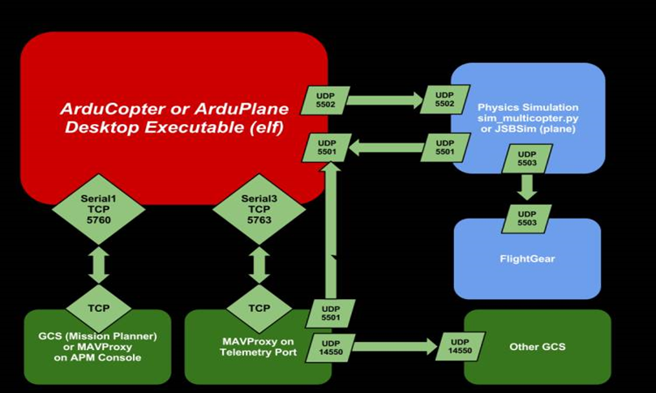
The SITL (software in the loop) simulator allows you to run Plane, Copter or Rover without any hardware. SITL Architecture:
Bansilal Ramnath Agarwal Charitable Trust’s
Vishwakarma Institute of Information Technology
Department of Electronics & Telecommunication

Slide 18

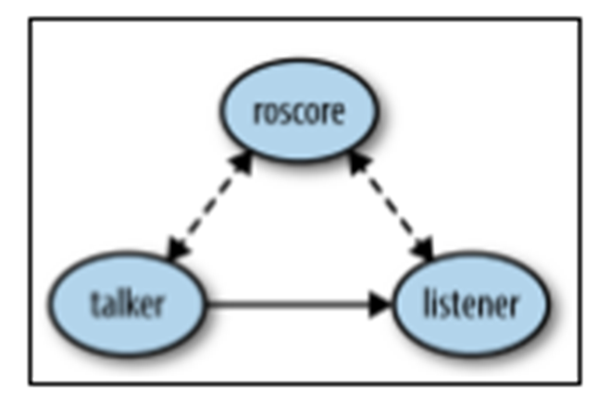
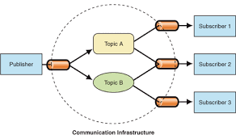
ROS?
ROS, the Robot Operating System, is an open source framework for getting robots to do things.
The Robot Operating System (ROS) is a framework for writing robot software. It is a collection of tools, libraries, and conventions that aim to simplify the task of creating complex and robust robot behavior across a wide variety of robotic platforms.
Bansilal Ramnath Agarwal Charitable Trust’s
Vishwakarma Institute of Information Technology
Department of Electronics & Telecommunication

Slide 19
Why to use ROS?
The short answer is because it will save you time. ROS provides all the parts of a robot software system that you would otherwise have to write. It allows you to focus on the parts of the system that you care about, without worrying about the parts that you don’t care about.
Reliable
Uses TCPROS or UDPROS protocol for communication.
Bansilal Ramnath Agarwal Charitable Trust’s
Vishwakarma Institute of Information Technology
Department of Electronics & Telecommunication

Slide 20
Terms to understand for implementing ROS
ROS Packages
ROS Nodes
ROS Topics
ROS Publisher(Python Script)
ROS Subscriber(Python Script)
Bansilal Ramnath Agarwal Charitable Trust’s
Vishwakarma Institute of Information Technology
Department of Electronics & Telecommunication

Slide 21
APPLICATION
Search and rescue, forest fire monitoring and fighting, flood and earthquake response, etc.
First Aid delivery
Military observation of regions
Theatrical Performance
Building inspections - more drones, more coverage
Agriculture
This type of system can be use for surveillance on prohibited areas.
Bansilal Ramnath Agarwal Charitable Trust’s
Vishwakarma Institute of Information Technology
Department of Electronics & Telecommunication

Slide 22
REFERENCES
https://www.theguardian.com/technology/2014/aug/15/harvard-kilobot-swarm-future-of-robotics[1]
https://pdfs.semanticscholar.org/645e/6080cee6d31fdda903809692ea6ab58b5990.[2]
https://www.researchgate.net/publication/264457775_Swarm_Intelligence_Concepts_Models_and_Applications[3]
https://www.hindawi.com/journals/isrn/2013/608164/[4]
http://www.techferry.com/articles/swarm-intelligence.html#aspects [5]
https://www.nrcresearchpress.com/journal/doi/10.1139/juvs-2018-0009?mobileUi=0#.XYLjUSgzbIV
https://www.thebalancecareers.com/military-and-civilian-drone-use-4121099
https://www.researchgate.net/publication/264457775_Swarm_Intelligence_Concept_Models_and_Applications
https://www.hindawi.com/journals/isrn/2013/608164/
https://www.sciencedirect.com/topics/agricultural-and-biological-sciences/swarms
Bansilal Ramnath Agarwal Charitable Trust’s
Vishwakarma Institute of Information Technology
Department of Electronics & Telecommunication

Slide 23
Thank You
Bansilal Ramnath Agarwal Charitable Trust’s
Vishwakarma Institute of Information Technology
Department of Electronics & Telecommunication

